Slide 1

Patient Evaluation
Dr Preety Tuli

Slide 2
What we will learn in Patient centered care !
Gather information from patient
Problem list
Explain required investigations/ findings/diagnosis
Discuss medical questionnaire/perform review of system, precautions considered while planning extraction.
Explain treatment plan (PHASES)
Managing acute problems (Acute Phase)
Disease control phase-Common Conditions & Their Management
Definitive Phase – Active Clinical Management; Replacement & Maintenance

Slide 3
Case Scenario – Irreversible Pulpitis
Scenario: A 32-year-old male presents with severe, lingering pain in the upper left molar region, especially when consuming hot beverages. The pain often radiates to the ear and worsens at night, disrupting sleep. Patient is medically healthy and non-smoker. Clinical Findings includes deep carious lesion with respect to tooth 26. Diagnostic test revealed prolonged pain on thermal testing (especially heat) and tenderness on percussion. IOPA with respect to 26 shows large radiolucency approaching the pulp in tooth 26. Explain findings and diagnosis.

Slide 4
Basic steps to follow
Acknowledge Chief Complaint
Cause and Course of Illness: • When did the pain start • Any history of deep decay or trauma • Is the pain spontaneous or only on stimulus • Pain relieved by medication or persists
Gather specific (Medical and Dental): • Any recent dental treatment
Clinical Exam Findings (Problem List): • Deep caries close to pulp • Prolonged response to thermal test • Tender on percussion
Diagnosis – Irreversible pulpitis is an inflammation of the pulp that cannot heal on its own and usually requires root canal treatment to save the tooth. Symptomatic Apical Periodontitis means that the inflammation has extended beyond the inside of the tooth and is now affecting the bone around the root.

Slide 5
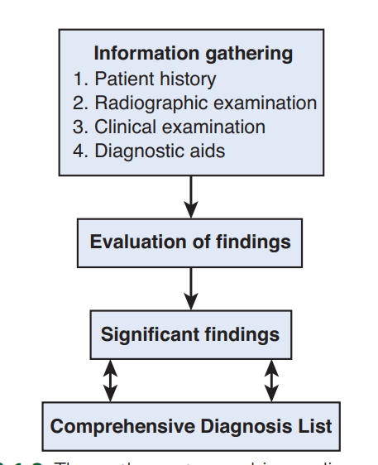
DIAGNOSTIC WORKFLOW
Letter | Component | Explanation
C | Chief Complaint | What patient reports as primary reason for visit
O | Other Conditions | Medical & dental history (systemic diseases, allergies, medications, etc.)
F | Findings – Clinical | Extraoral and intraoral examination findings
F | Findings – Radiographic | Radiographic interpretation (periapicals, OPG, bitewings, etc.)
E | Establish Diagnosis | Synthesizing clinical + radiographic + history to conclude diagnosis
E | Execute Treatment Plan | Phased treatment planning based on the diagnosis

Slide 6
CHIEF COMPLAINT
Caries and non-carious lesions
Periodontal/ pulp/ or Peri-apical pathology
Pathology of the periodontium
Defective restorations, an oral prosthesis and/or implants
Disorders of the temporomandibular joint (TMJ)

Slide 7
History of Chipping/Fracture
History of pain- SOCRATES
S: Site
O: Onset
C: Character
R: Radiates
A: Associated symptoms swelling/discharge/fever/lymphadenopathy
T: Time/Duration
E: Exacerbating/Relieving factors
S: Severity
Any history of recent trauma
Was the tooth/ restoration in hyper occlusion
Were lateral forces on the tooth excessive
Has there been loss of vertical dimension of occlusion
Any history of bruxism/clenching

Slide 8
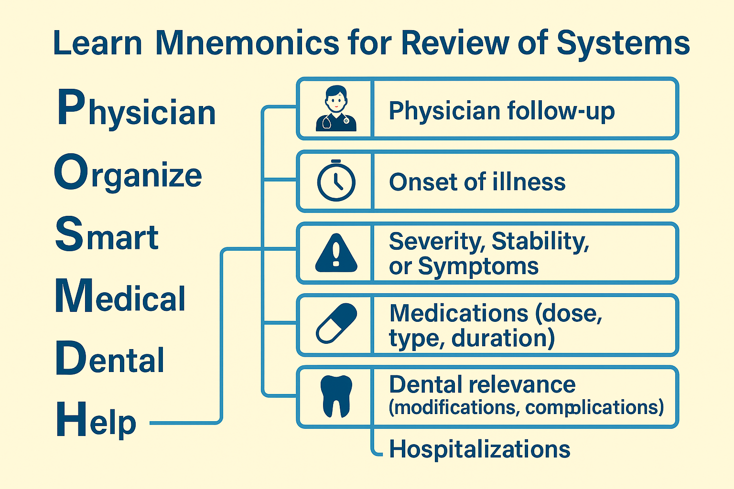
Medical History
REVIEW OF SYSTEMS
Look at Directives and distribute time accordingly.
Refer to given history.
Refer to the given Medical chart.

Slide 9
Medication History
Prescription medications
Over-the-counter medications / herbal remedies / vitamins / nutritional supplements
Any peculiar or adverse reaction to any medication
Any blood thinners (e.g., Coumadin, Xarelto, Pradax, Eliquis, Clopidogrel, Aspirin)
Any recreational drugs (e.g., Cocaine, Marijuana, Amphetamines)
Personal history: Smoking / Alcohol
Past Dental History
Date of last dental examination.
Frequency of dental visits.
Types of treatment received, and history of any problems during past treatment.

Slide 10
Assessment/Diagnostic test
Careful inspection.
Pulp vitality testing
Percussion test
Mobility testing
Occlusal assessment
Selected radiographic or other imaging.
Determination of the prognosis for a tooth

Slide 11
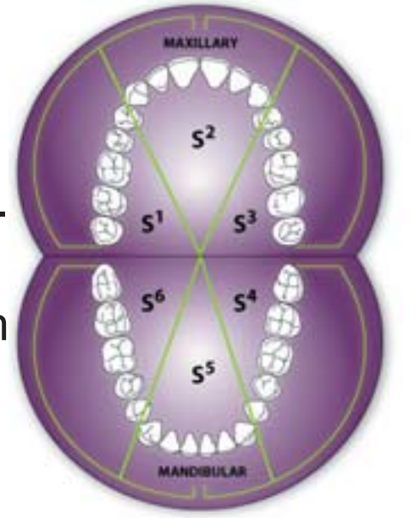
Periodontal Screening & Recording
Determine need for a comprehensive periodontal evaluation
Evaluation of all sites at periodontal risk
Adult patients, age 18 and older
Sextants are labelled S1-S6

Slide 12
Periodontal Screening & Recording
0 | Gingival tissues are healthy with no BOP | Implications
1 | Bleeding on probing (BOP) | No further documentation needed.
2 | Supragingival or subgingival calculus and/or defective margins are detected.
3 | probing depth between 3.5 and 5.5 mm. | Comprehensive periodontal assessment of entire mouth.
4 | probing depth of greater than 5.5 mm.
X | Any sextant that is completely edentulous.
 | Furcation involvement, mobility, mucogingival problems, or recession ≥3.5mm

Slide 13
Radiographic Examination
A thorough clinical examination, consideration of the patient history, review of any prior radiographs, caries risk assessment and consideration of both the dental and the general health needs of the patient should precede radiographic examination.
Attempt to obtain previous radiographs.

Slide 14
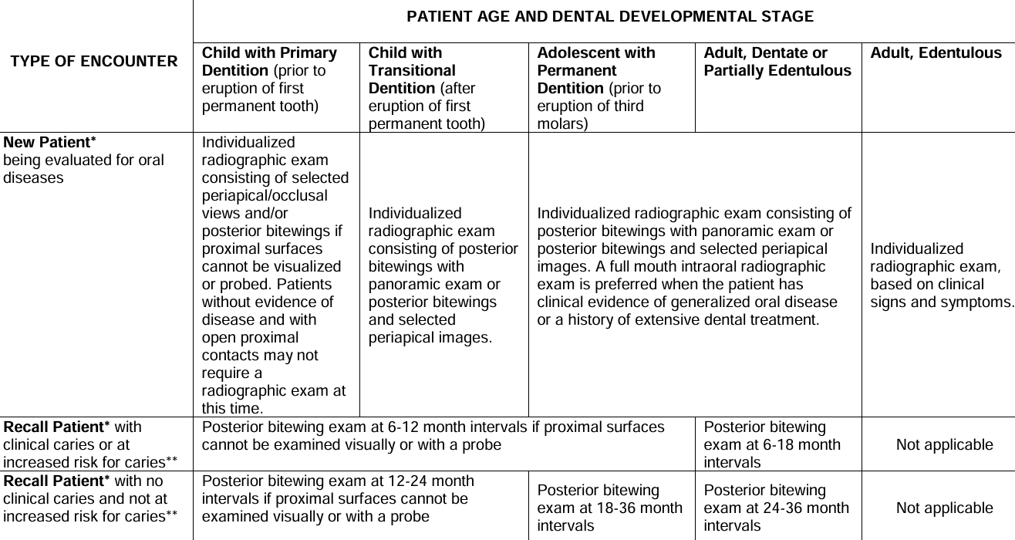

Slide 15
Systemic Assessment
Dr Preety Tuli

Slide 16
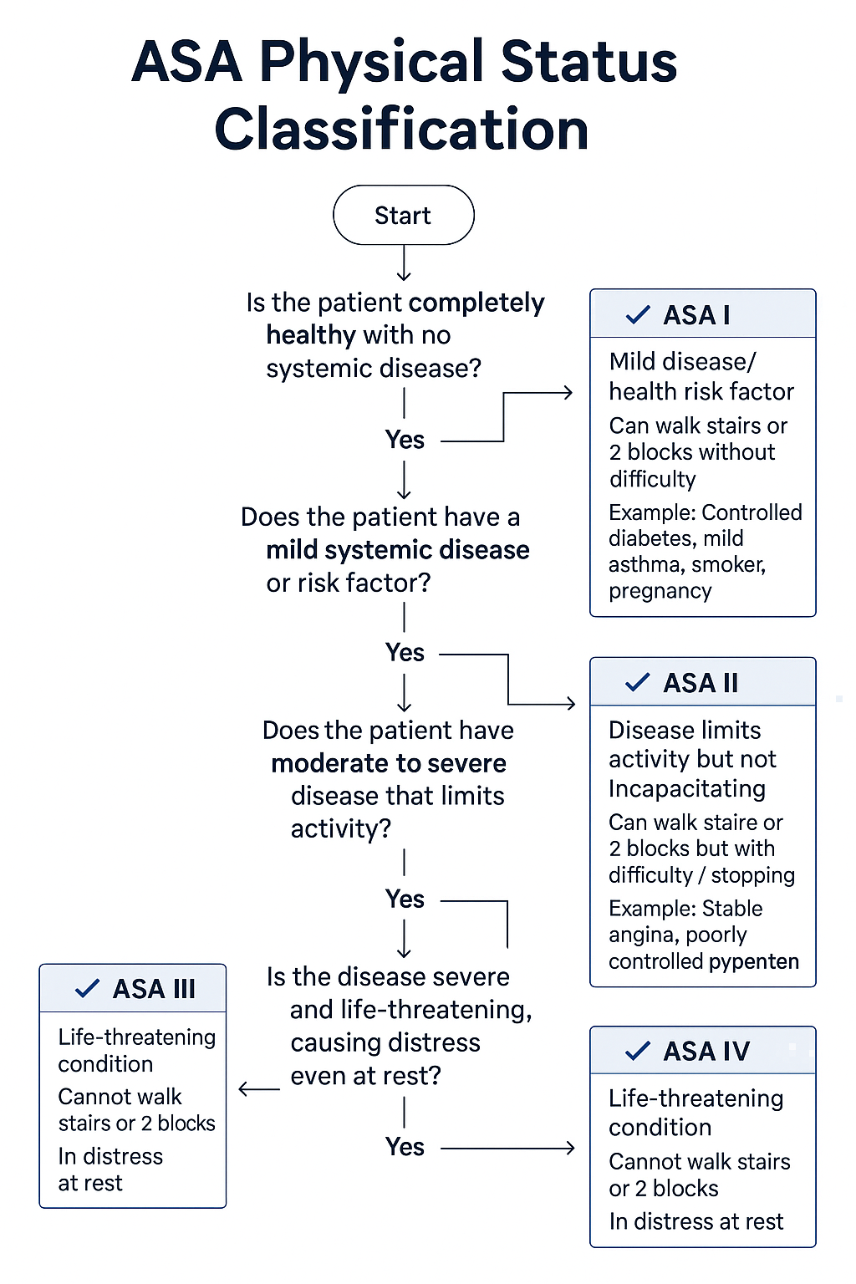
1
Identify status of current medical condition
2
Modify dental treatment based on systemic health
3
Prevent Medical Emergencies in office
4
Prevent Serious Postop complications

Slide 17
Review of system
Mnemonics

Slide 18
CARDIOVASCULAR DISEASE
Stable Patients
Consider these treatment modifications
Stress Reduction: Short, morning appointment (calm environment/ preoperative anxiolytics)
Medication Management: Ensure the patient takes their medications as prescribed.
Monitoring: Continuously monitor vital signs
Local Anesthesia with minimal vasoconstrictors (e.g., epinephrine). Avoid epinephrine-impregnated retraction cord
Pain Control: Use effective pain management to prevent postoperative pain, which can induce stress and angina.
Emergency Preparedness: Drugs and have emergency protocols in place.

Slide 19
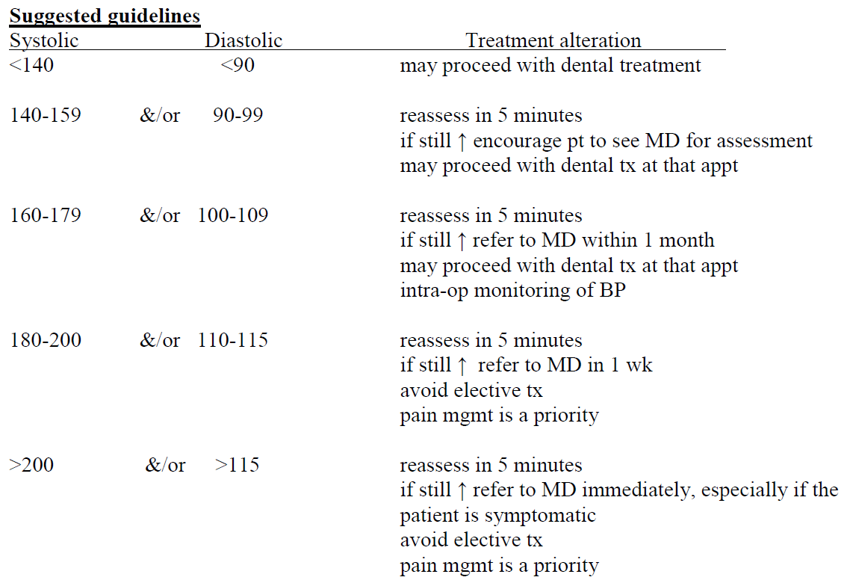
Hypertension

Slide 20
Stroke
Current neurological status (speech, swallowing, motor function).
Defer elective dental treatment for at least 1 month following a stroke.

Slide 21
Aspect | Pacemaker Surgery | Coronary Stent Placement
Review of system | Cardiac evaluation Medication (Beta-blocker, anticoagulants) | Cardiac evaluation Medication (Dual Antiplatelet Therapy (DAPT): Aspirin+ Clopidogrel (or Ticagrelor/Prasugrel) Statins - Beta-blockers - ACE inhibitors)
Dental Concerns | Electromagnetic interference (EMI) (electrosurgery units) Bleeding risk minimal unless on anticoagulants | High bleeding risk due to DAPT Risk of stent thrombosis if antiplatelets are stopped prematurely Coordination with cardiologist essential
Modifications for Extraction | Avoid ultrasonic devices near chest | Minimize trauma Local hemostatic measures Discuss with cardiologist if DAPT is active and surgery is urgent

Slide 22
Patient with Bleeding risk
No discontinuation of Aspirin or Clopidogrel without neurologist’s clearance
Plan minimally invasive surgical technique
Use local hemostatic measures (e.g., pressure packs, suturing, tranexamic acid rinse, gelatin sponge)
Post-op pain control with acetaminophen (avoid NSAIDs due to bleeding risk)
Provide written and verbal post-op instructions for how to manage bleeding if appeared after surgery
Assess bleeding risk of patient

Slide 23
Patient on WARFARIN (COUMADIN)
Recent INR reading. How often do you get it checked ? When was your last test?
Need recent INR prior to surgery (within 48 hrs, 24 hrs if possible)
INR is ≤ 3.5- Minor surgery ( simple extractions)
INR is ≥ 3.5, then delay invasive procedure; Refer to MD & specialist.
For bleeding emergency - pt to go to Hospital emergency dept - has reversal agent (vitamin K)

Slide 24
Joint Replacement
Follow current guidelines of RCDSO and CDA. American heart association
Do a medical consult to discuss antibiotic use if required
If complications after joint replacement: discussion is needed with Orthopaedic surgeon.
If antibiotics are recommended by MD:
(a) Then MD should prescribe the antibiotics.
(b) MD should advise what procedures antibiotics are recommended for.
(c) MD should decide which antibiotic should be used.
When was the surgery done
How often do you follow up
Any complications due to treatment Hematoma Wound drainage
Were you advised to take antibiotics prior to dental treatments If yes, who recommended it And when did you last take antibiotic prophylaxis
Any complication/infection with your prosthetic joint

Slide 25
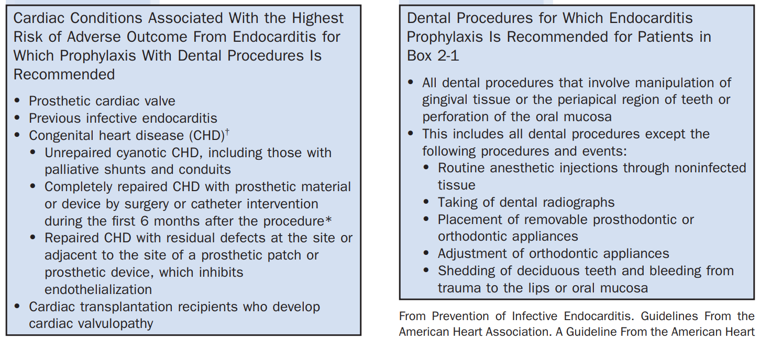
Current American Heart Association Recommendations (2007)
No antibiotic prophylaxis required
Mitral valve prolapse
Congenital heart disease
Rheumatic heart disease
Stent placed in heart
Pacemaker

Slide 26
All About Attacks
If Patient has history of attack in last dental visit:
(type of visit, procedure, stress level, how was it managed)
Letter | Stands For | Details | Modifications
M | Medications | Current meds, compliance, effect of medication | Bring medications
O | Onset & Frequency | When did it first start, at what usual time How often | Schedule appointments when attacks are least likely
T | Triggers | What provokes it (e.g., exercise, allergens, stress, infection) | Avoid triggers
H | Hospitalization History | Any ER visits or admissions for this condition | Medical Consult (4 weeks/1 month)
E | Episode Duration | How long does each attack last
R | Recent Changes in attack | Onset/frequency/Severity | Medical Consult

Slide 27
Asthma Allergy
Semi supine or upright chair position for asthma.
If sedation is required, nitrous oxide–oxygen inhalation is best. Benzodiazepines can be given short term for well controlled cases.
Narcotics (opioids) and barbiturates are avoided in severe asthma.
Avoid ASA in all patients with asthma, avoid NSAIDS only in persistent cases.
Avoid NSAIDS with ASA induced asthma and nasal polyps.
Allergen details.
Documented/ Not Documented.
Type of reaction: Trouble breathing or significant swelling
Past hospitalization
Latex allergy
Be Aware: Gloves, rubber dam, rubber in anesthetic carpules, suction tubing, mixing bowls, blood pressure cuffs/pump, stethoscope, bite block, prophy cup, etc.

Slide 28
Pregnancy
Delay routine treatment in 1st Trimester
Delay all elective surgery until delivery.
Minimize radiographic exposure.
Short morning appointments, Semi reclined left lateral position.
Avoid ASA , Anxiolytic drugs, Tetracyclines throughout pregnancy.
Avoid Nitrous oxide in 1st trimester but can give in 3rd trimester provided its 50 % O2.
Avoid NSAIDs in third trimester, can be given in 1st and 2nd trimesters (Ibuprofen). Avoid Opioids in 1st and 2nd Trimesters.
Type of treatment procedure
Trimester
Complications in previous or current pregnancy

Slide 29
Medical Referral
Date
From: ID
To: Physician
RE: XXXXXX (Pt name) (DOB:)
Dear Doctor:,
Patient named X, presented to clinic for multiple extractions of mobile teeth. M/H revealed uncomplicated joint replacement 5 years ago and Diabetes type 2 (good control).
Past Dental History revealed patient was prescribed antibiotic prophylaxis for multiple extractions. Planned treatment can be accomplished with minimal stress using local anesthetic containing 2% lidocaine and 1:100,000 epinephrine.
As per the current guidelines, its not mandatory to give prophylactic antibiotics for joint replacement. Please evaluate and advise or prescribe antibiotics if you find it necessary for the above-mentioned dental treatment. If there are any other health considerations, I should be aware of, please let me know. Should you require any additional information, please do not hesitate to contact me. Informed Consent of the patient attached herewith.
Sincerely,.
1. Patient identifying information.
2. The patient’s history and/or the findings and patient’s medication history with dosages.
3. The proposed dental treatment.
4. A specific request for information or action.
5. The dentist’s name, address, telephone and facsimile phone numbers.

Slide 30
COPD
Short appointment; treat them at the end of the day.
Stress Reduction Protocol; Avoid anxiolytic drugs (barbiturates/BZD) & opioids.
Avoid supine position (upright chair position is preferred)
Severe COPD:
Avoid O2 (specifically N2O)’ rubber dam
Refer to hospital.
Consider Smoking cessation

Slide 31
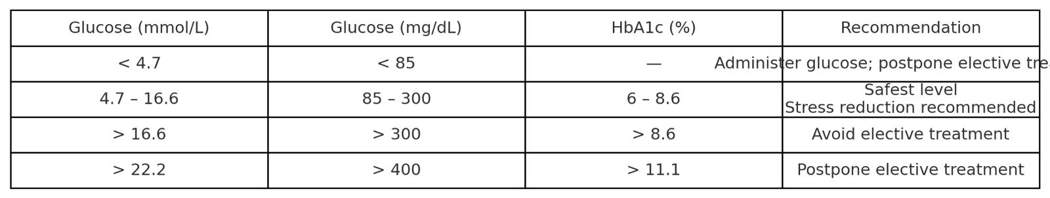
Diabetes
Confirm if glycosylated hemoglobin (HbA1c) <7%
Appointment should not interfere with usual medication dose/ meal. Prefer morning appointments.
Take glucometer readings if patient miss taking FBS.
Oral glucose source ready, know emergency protocols
Treat all infections aggressively. Ensure excellent oral hygiene, and encourage preventive care

Slide 32
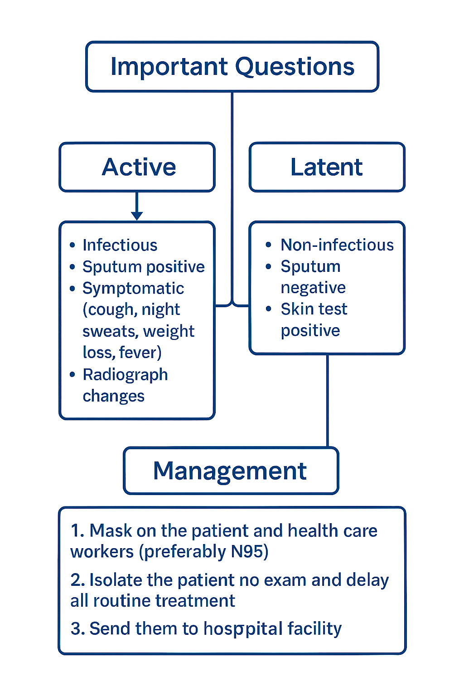
Tuberculosis

Slide 33
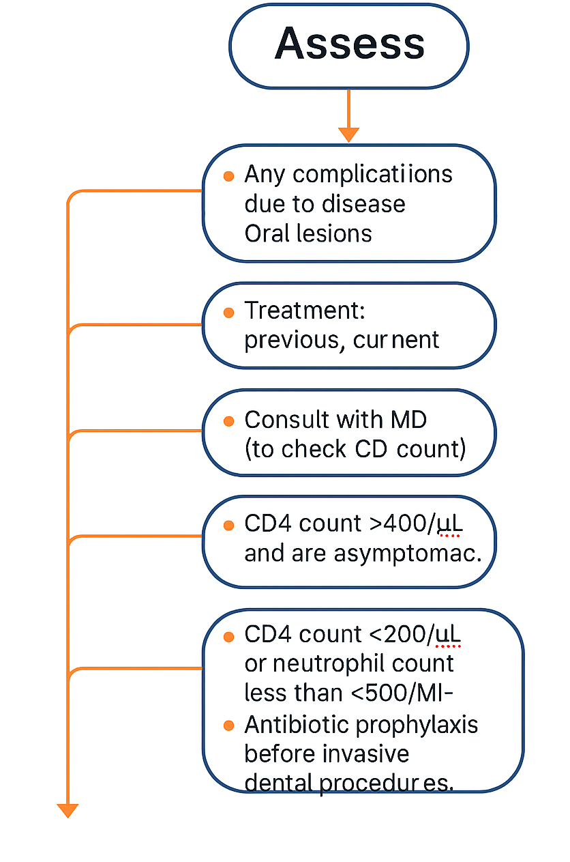
HIV- infection
Bleeding problems (platelets may be decreased)
Use routine practice (standard precautions/universal precautions)

Slide 34
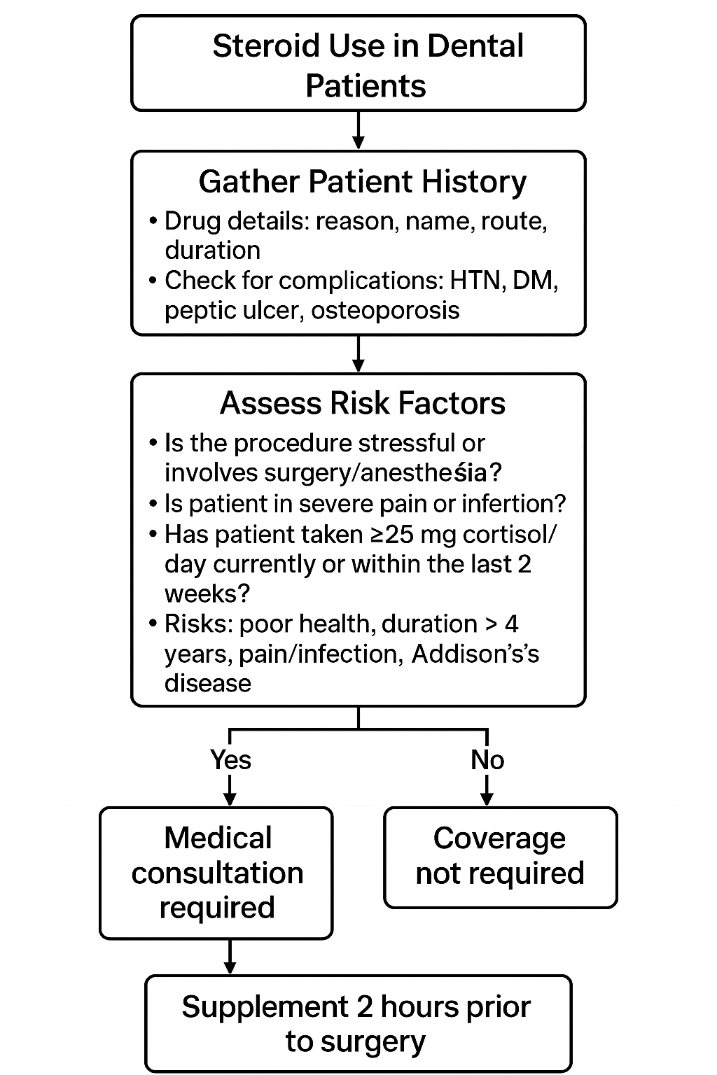
Patients taking steroid
Coverage is required if:
IGNITE DENTAL VISION

Slide 35
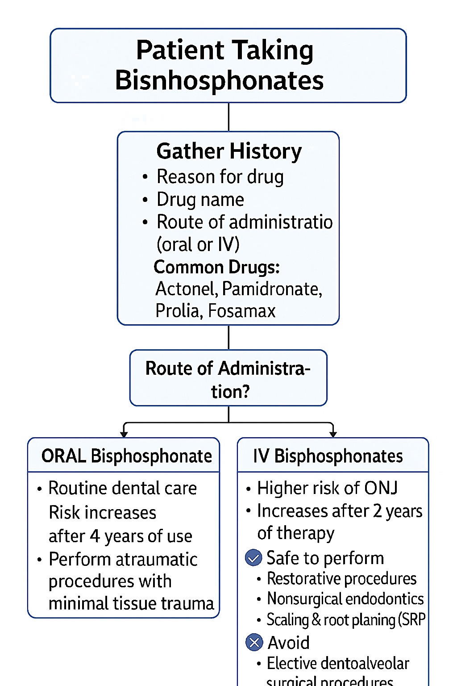
Patients taking bisphosphonates
IV Bisphosphonates

Slide 36
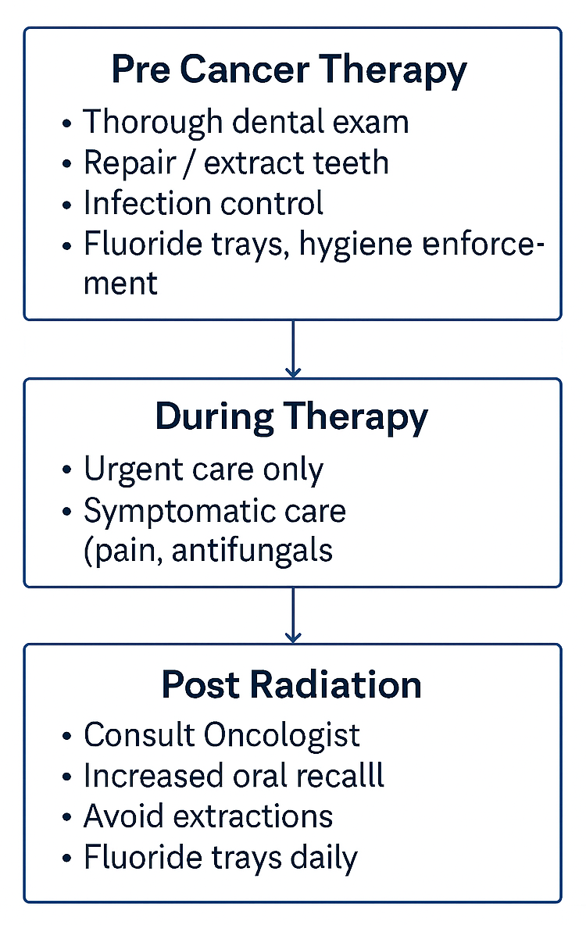
Cancer
Type of cancer
Treatment- type/timeline: Surgery Radiation Chemotherapy
Areas of the head and neck region irradiated & Amount of radiations
Any complications due to treatment
Are you currently using any preventive treatment as per dentist recommendations
IGNITE DENTAL VISION

Slide 37
Unstable Medical Condition
Elective dental care should be deferred.
Medical consultation obtained.
Treat them in a hospital facility.
Follow Stress Reduction Protocol.
Take consent to refer to physician
Manage any current emergency- analgesic/smoothen sharp edges
Symptomatic condition.
Attack: increased severity/ Frequency.
Any recent hospitalizations or changes in Medical condition
Incomplete info regarding Medications

Slide 38
THANK YOU

